Slide 1
Machine learning for data science – Linear regression
Deadline: December 17, 2022

Slide 2
Machine learning technic using simple linear regression
- WRITE PYTHON CODE to predict Home Prices
Notes:
Machine Learning with Python

Slide 3
Prices of home
Area | Price
2600 | 550,000.00
3000 | 565,000.00
3200 | 610,000.00
3600 | 680,000.00
4000 | 725,000.00
Notes:
In this table, the home prices based on area in sq feet. Using these data we will build machine learning model that can tell me the prices of the home base on Area

Slide 4
Prices of home
Area | Price
2600 | 550,000.00
3000 | 565,000.00
3200 | 610,000.00
3600 | 680,000.00
4000 | 725,000.00
Given these home prices find out the prices of the following:
3300 square feet
5000 square feet
Notes:
Given these home prices find out the prices of the following:
3300 square feet
5000 square feet

Slide 5
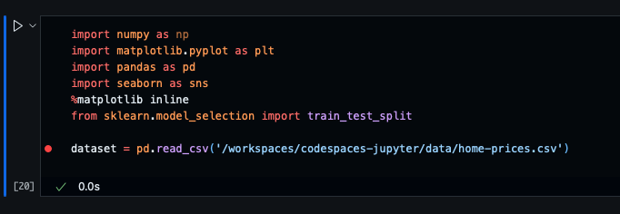
1. Create a csv file containing the information for Area and Price, upload the file to the Jupyter
df = pd.read_csv(“filename.csv")
df
Upload / Post your answer here

Slide 6
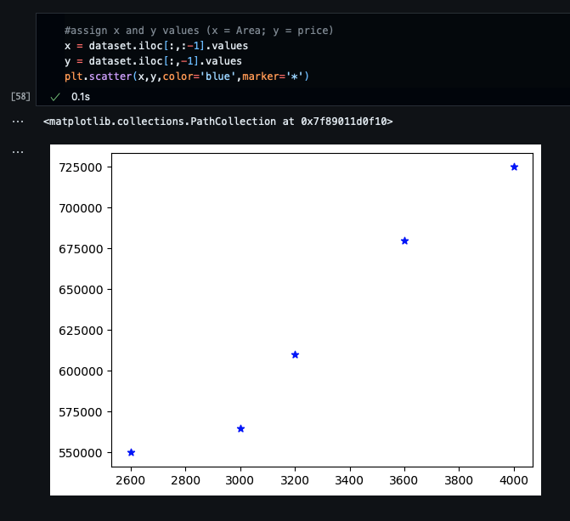
2. MODIFY THE GRAPH TO: color=‘blue', marker=‘*'
%matplotlib inline
plt.scatter(df.area,df.price)
Upload / Post the graph here

Slide 7
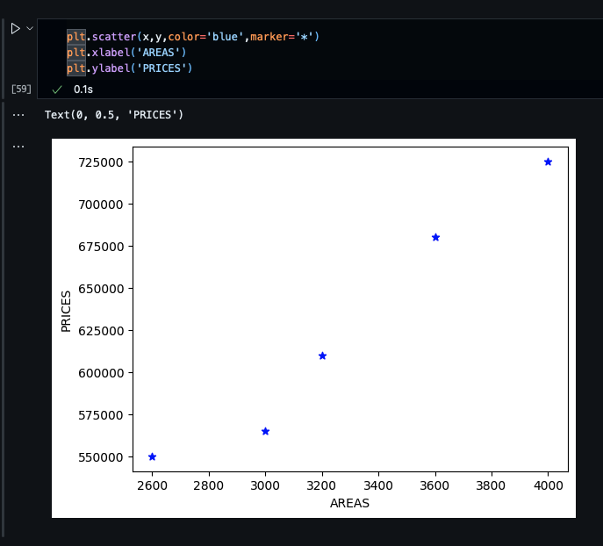
3. MODIFY THE GRAPH TO: X =‘areas', y =‘prices'
%matplotlib inline
plt.scatter(df.area,df.price)
Upload / Post the graph here

Slide 8
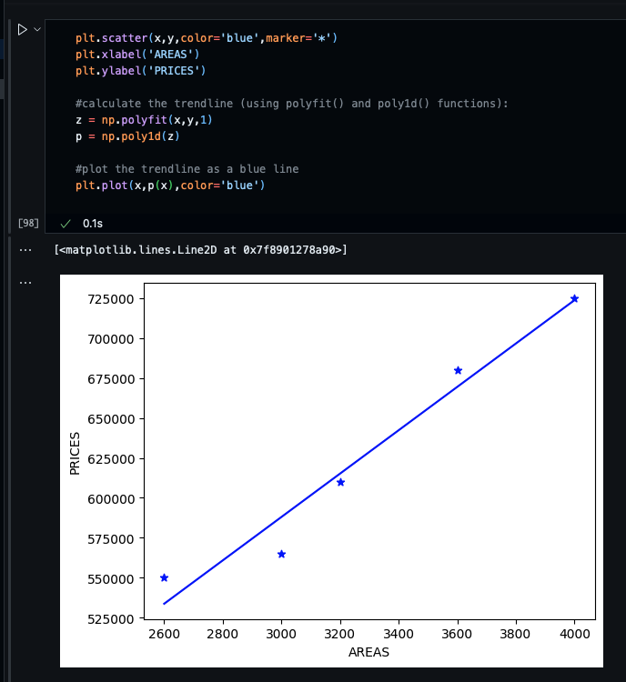
4. MODIFY THE GRAPH TO: Add prediction line or trendline Color = blue
%matplotlib inline
plt.scatter(df.area,df.price)
Upload / Post the graph here

Slide 9
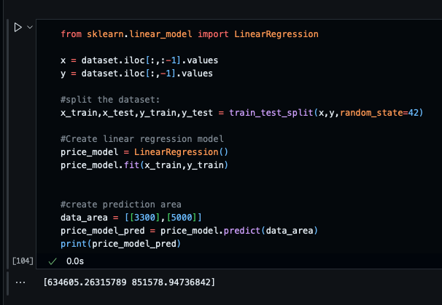
5. PRICES PREDICTION
Code:
Given these home prices find out the prices of the following: (using the reg.predict())
3300 square feet
5000 square feet
Answer:
a. 634,605.26
b. 851,578.95

Slide 10
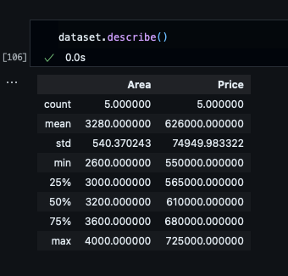
6. Describe Function
.describe()
Upload / Post your answer here

Slide 11
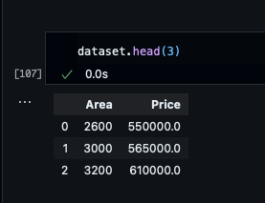
7. Create a separate csv file containing the AreaS only, upload the file to the Jupyter
Show data frame, head = 3
Upload / Post your answer here

Slide 12
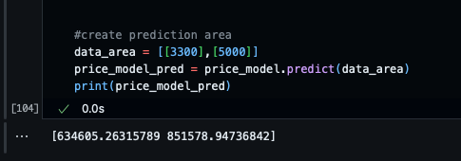
8. Create a prediction for the given new file
reg.predict()
Upload / Post your answer here (array)

Slide 13
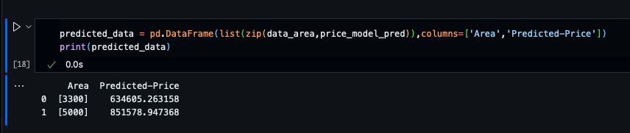
9. assign/Create a column for the predicted price of the given areas
df2['Predicted-Price']
Upload / Post your answer here

Slide 14
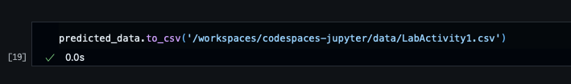
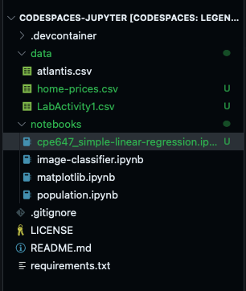
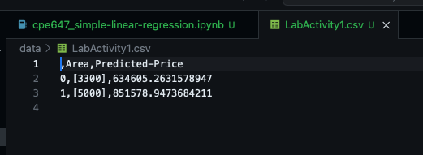
10. Create a csv file for the given areas with predicted prices
.to_csv(“LabActivity1.csv")
Upload / Post your answer here

